Slide 1
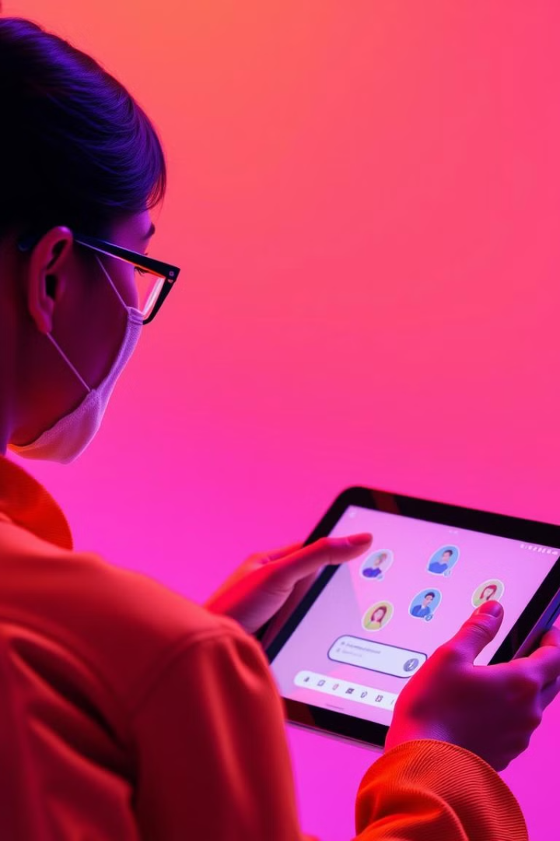
Poly.AI: Revolutionizing Conversational AI
Poly.AI is an innovative company that focuses on creating cutting-edge conversational AI solutions. They strive to make human-computer interaction more natural and intuitive.

Slide 2
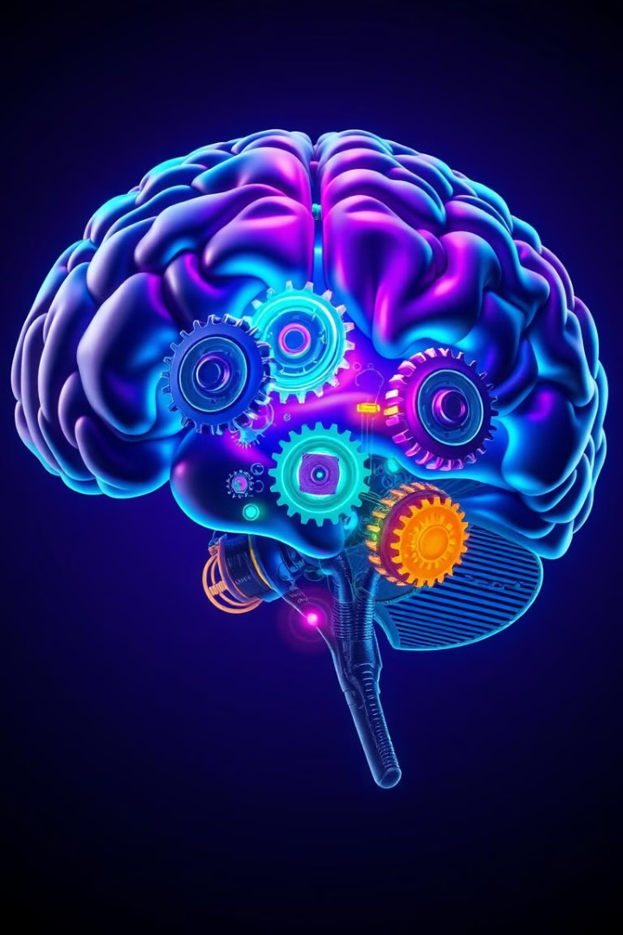
What is Poly.AI?
Poly.AI develops advanced conversational AI models that can understand and respond to human language in a sophisticated way. Their technology is designed to mimic human conversation.
AI-Powered Chatbots
Deep Learning
Poly.AI's AI chatbots are capable of holding natural and engaging conversations with users. These chatbots can be used for a variety of purposes, from customer service to personal assistance.
Poly.AI leverages deep learning algorithms to train their AI models, enabling them to learn from vast amounts of data and improve their conversational abilities over time.
Human-Like Interactions
The goal of Poly.AI's technology is to create AI chatbots that can interact with humans in a way that feels natural and engaging, blurring the lines between human and artificial intelligence.

Slide 3
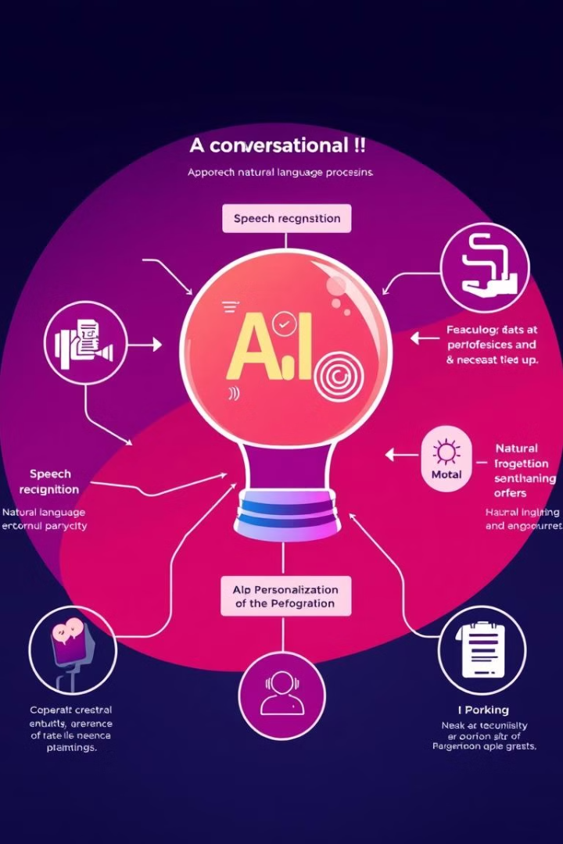
Capabilities of Poly.AI
Poly.AI's AI chatbots are equipped with a wide range of capabilities that make them versatile and powerful tools. Their features cater to diverse use cases and industry needs.
1
Speech Recognition
2
Natural Language Understanding
Poly.AI's AI chatbots can understand and interpret human speech, allowing for natural voice-based interactions.
They can comprehend the meaning and context of user inquiries, enabling them to provide accurate and relevant responses.
3
Personalization
4
Sentiment Analysis
Poly.AI's AI chatbots can adapt their interactions based on user preferences and past conversations, creating a more personalized experience.
They can analyze the sentiment behind user messages, allowing them to adjust their responses accordingly.

Slide 4
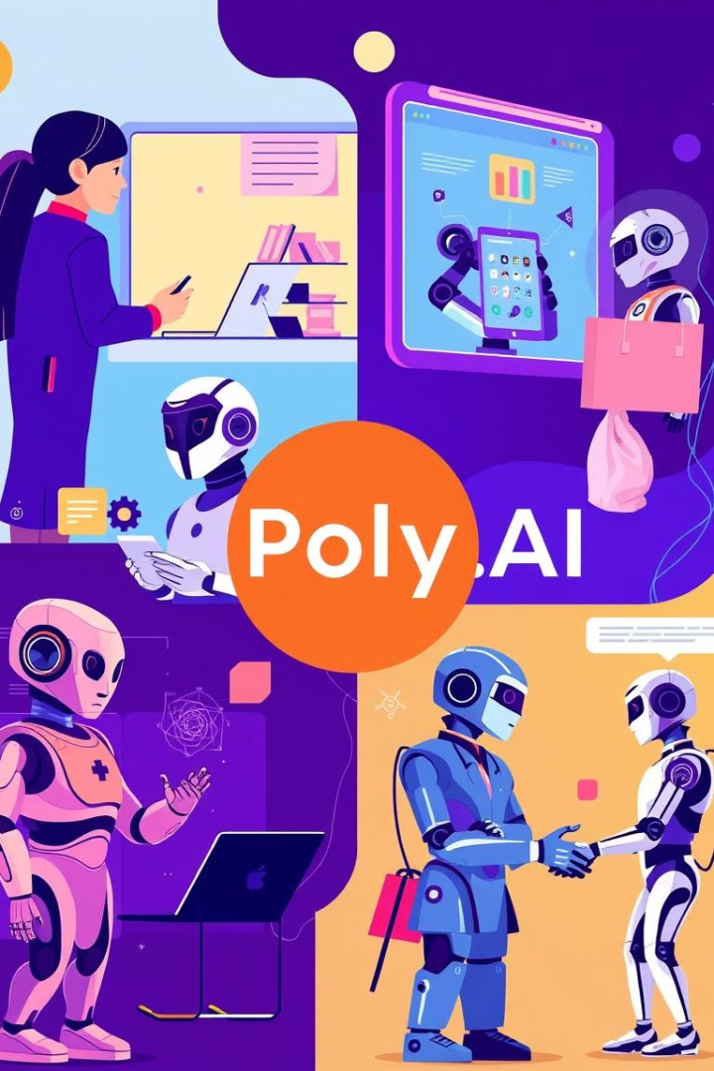




Use Cases for Poly.AI
Poly.AI's conversational AI technology has a wide range of applications across various industries, empowering businesses and organizations to enhance their operations and provide better experiences for their users.
Customer Service
Poly.AI's chatbots can provide 24/7 support, answer common questions, and resolve issues quickly and efficiently.
E-commerce
They can help customers find products, place orders, and track shipments, creating a more seamless online shopping experience.
Healthcare
Poly.AI's chatbots can assist patients with scheduling appointments, accessing medical information, and managing their health.
Education
They can provide personalized learning experiences, answer student questions, and offer support for educators.

